Slide 1

Football Team Generator
Muhammad Shayekur Rahman
22MayEnable2

Slide 2



Agenda
Planning
Back End
Front End
Testing
Demonstration

Slide 3

Introduction
I have built a website which allows a user to create a football team, so that they may visualize where players are positioned. This may be useful for amateur football players to organize Sunday league matches.

Slide 4

Planning
Identified user Stories.
The core functionality of a user being able to create, read, update and delete information.
Skills/Languages used: Agile, Java, Spring, HTML, CSS, JAVASCRIPT, BOOTSTRAP, Axios.
Git was used for version control. Implemented FB methodology.

Slide 5

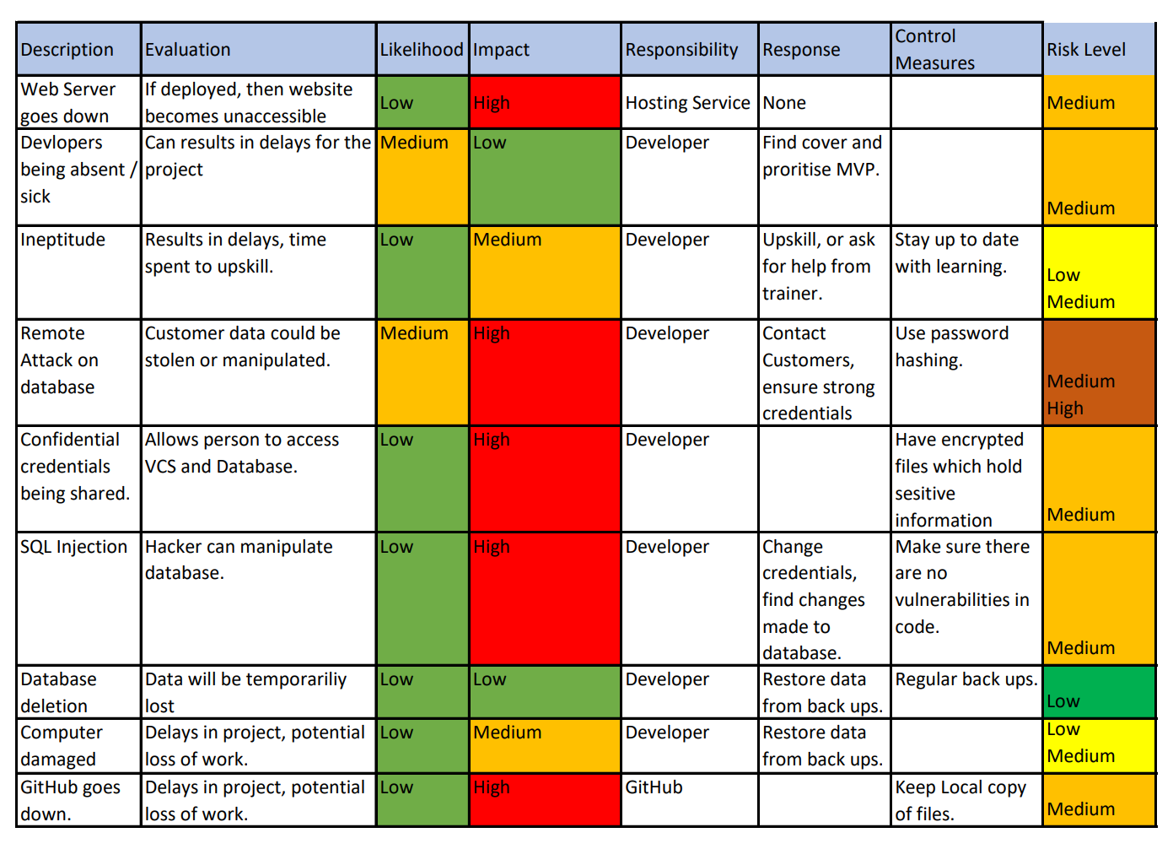
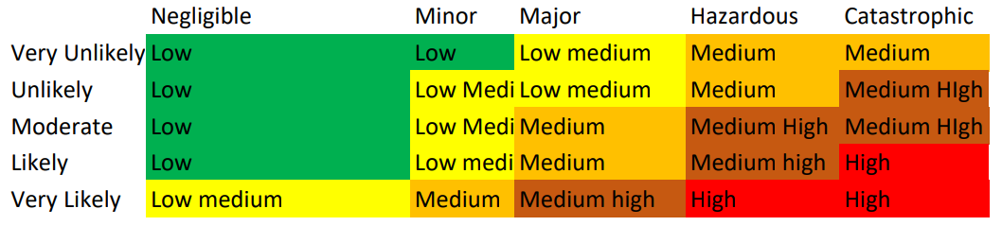
Risk Assessment

Slide 6
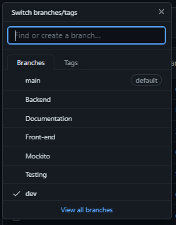
Git for Version Control

Slide 7
MoSCoW
Must Haves:
A function which can create a team
A function which can delete a team
A function which can read team information
A function which creates a player
A function which can read player information
A function which can update player information
A function which can delete player information
Should haves:
A Team should have a name
A player should have a name
A player should have a position
At least 80% test coverage in backend
Could haves:
Login page
Game score tracker
Edit formation
Only creator can edit their team’s player information
Wont haves:
Front End Testing

Slide 8
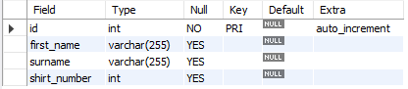
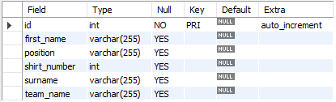
Database progression
Redesign
By creating more attributes, allowed for more creativity and user functionality as would be demonstrated.
In future: I would add a separate table for teams, so that users could have duplicate team names.

Slide 9
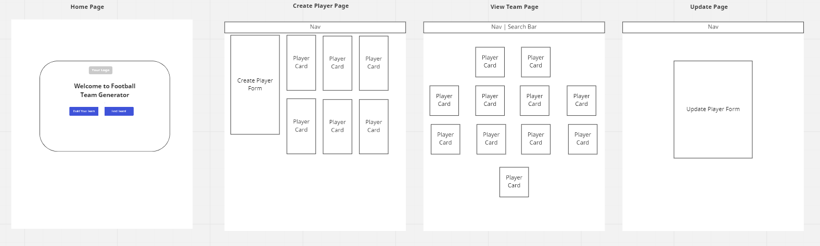
Front End - Wire Frame

Slide 10
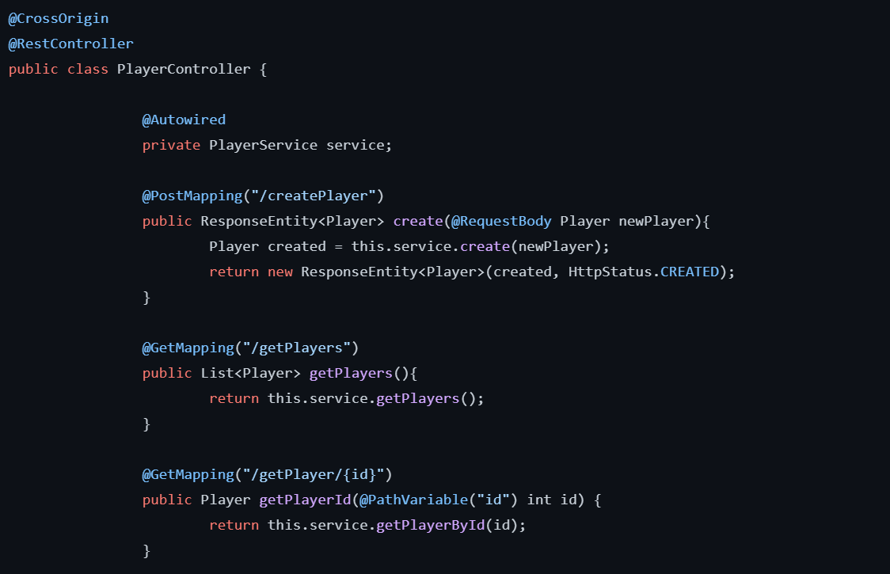
Back-End: Using Java and Spring
Here is an example of a method written in java which handles information from a request and creates an entry into the database via spring.
Using spring:
Eliminates the need to independently create factory and singleton classes;
Easy development

Slide 11
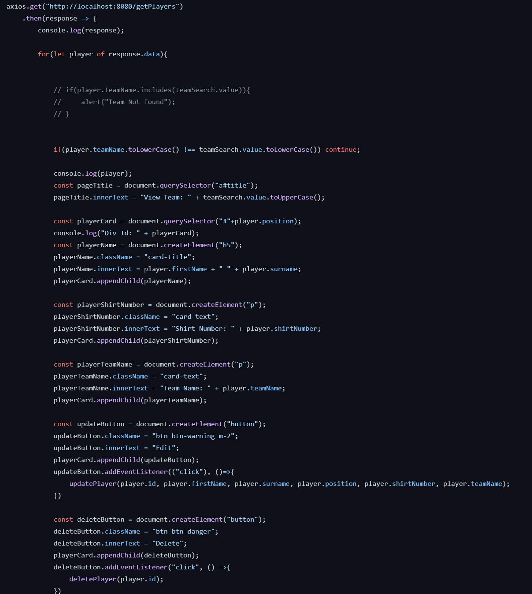
Front-End: HTML, CSS and JS
Used HTML to create the fundamental layout of page.
CSS and BootStrap were used for styling.
JavaScript was used in order to retrieve and handle information via axios and would display information onto page through DOM manipulation.
Here is an example of code which I used data in my table to refer to an element in HTML, this allowed me to display players in a formation which is useful for the user.

Slide 12
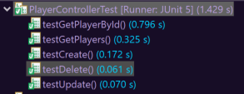
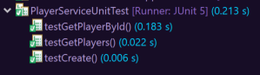
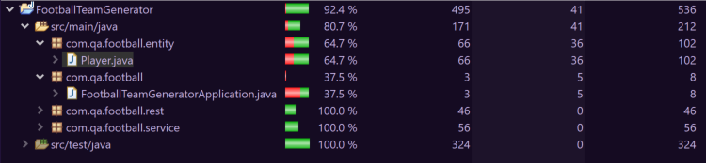
Testing (..as it stands)
Junit
Mockito
Coverage

Slide 13
Demonstration
Lets Build a Team!

Slide 14

Summary
I think the project went very well. I have gained a strong understanding of how a full stack web application works.
I would have liked to include a user login system, so that teams can be tied to a creator, and to also implement front end testing through selenium and sonarqube.

Slide 15
Thank You
Muhammad Shayekur Rahman
https://github.com/MuhammadShayekurRahman/Football-Team-Generato
Special Thanks to Jordan H and Jordan B.

